Slide 1
Hash Functions

Slide 2
Data Integrity and Source Authentication
Encryption does not protect data from modification by another party.
Need a way to ensure that data arrives at destination in its original form as sent by the sender and it is coming from an authenticated source.
Notes:
Modified ciphertext can often still be decrypted into plaintexts?

Slide 3
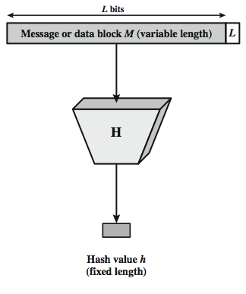

Hash Function
The hash value represents concisely the longer message
may called the message digest
A message digest is as a ``digital fingerprint'' of the original document
condenses arbitrary message to fixed size
h = H(M)
Notes:
A hash function H accepts a variable-length block of data M as input and produces a fixed-size hash value h = H(M). A "good" hash function has the property that the results of applying the function to a large set of inputs will produce outputs that are evenly distributed, and apparently random. In general terms, the principal object of a hash function is data integrity. A change to any bit or bits in M results, with high probability, in a change to the hash code. The kind of hash function needed for security applications is referred to as a cryptographic hash function. A cryptographic hash function is an algorithm for which it is computationally infeasible (because no attack is significantly more efficient than brute force) to find either (a) a data object that maps to a pre-specified hash result (the one-way property) or (b) two data objects that map to the same hash result (the collision-free property). Because of these characteristics, hash functions are often used to determine whether or not data has changed.
Stallings Figure 11.1 depicts the general operation of a cryptographic hash function. Typically, the input is padded out to an integer multiple of some fixed length (e.g., 1024 bits) and the padding includes the value of the length of the original message in bits. The length field is a security measure to increase the difficulty for an attacker to produce an alternative message with the same hash value.

Slide 4

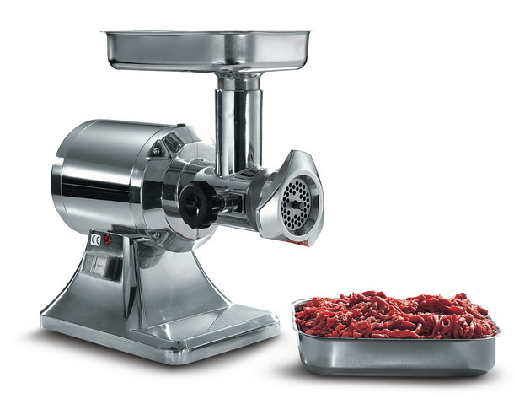
Chewing functions
Hashing function as “chewing” or “digest” function
Notes:
Hash functions, Tuma and properties.
One-wayness
First and second preimage resistance
Collision resistance
After a while he started to call them chewing functions
-->
So here we have some classic chewing functions

Slide 5
Hashing V.S. Encryption
Hello, world.
A sample sentence to show encryption.
k
E
NhbXBsZSBzZW50ZW5jZSB0byBzaG93IEVuY3J5cHRpb24KsZSBzZ
Hello, world.
A sample sentence to show encryption.
D
k
NhbXBsZSBzZW50ZW5jZSB0byBzaG93IEVuY3J5cHRpb24KsZSBzZ
Encryption is two way, and requires a key to encrypt/decrypt
This is a clear text that can easily read without using the key. The sentence is longer than the text above.
h
52f21cf7c7034a20 17a21e17e061a863
Hashing is one-way. There is no 'de-hashing’

Slide 6
Password Verification
Store Hashing Password
Verification an input password against the stored hash
Iam#4VKU
Iam#4VKU
Password store
h
h
661dce0da2bcb2d8 2884e0162acf8194
661dce0da2bcb2d8 2884e0162acf8194
661dce0da2bcb2d8 2884e0162acf8194
Hash Matching Exactly?
Password store
Yes
No
Grant
Deny

Slide 7
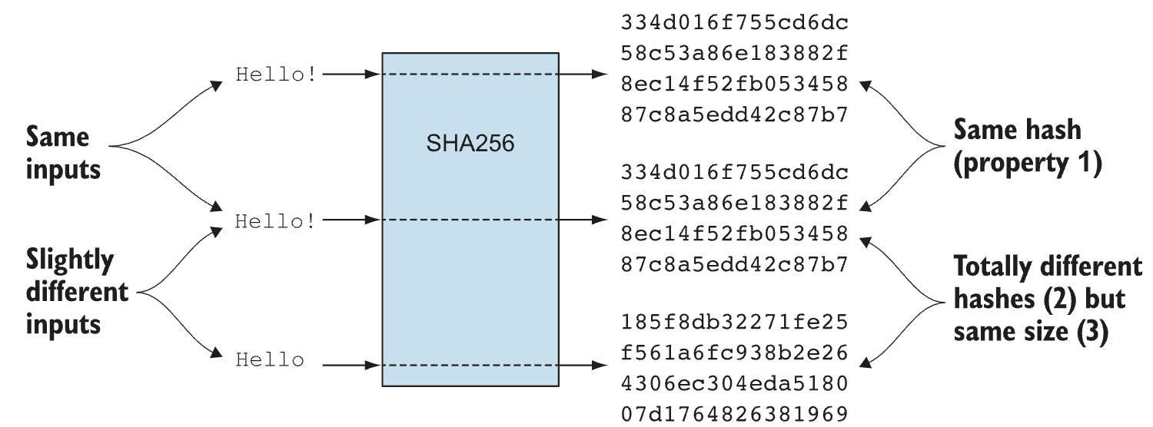

Slide 8
Hash Function Properties
Arbitrary-length message to fixed-length digest
Preimage resistant (One-way property)
Second preimage resistant (Weak collision resistant)
Collision resistant (Strong collision resistance)
Notes:
The first properties are requirements for the practical application of a hash function. The second property, preimage (for a hash value h = H(x), we say that x is the preimage of h) resistant, is the one-way property: it is easy to generate a code given a message, but virtually impossible to generate a message given a code. This property is important if the authentication technique involves the use of a secret value The fthird property, second preimage resistant, guarantees that it is impossible to find an alternative message with the same hash value as a given message. This prevents forgery when an encrypted hash code is used. If the fouth property, collision resistant, is also satisfied, then it is referred to as a strong hash function. A strong hash function protects against an attack in which one party generates a message for another party to sign. The final requirement, pseudorandomness, has not traditionally been listed as a requirement of cryptographic hash functions, but is more or less implied.

Slide 9
Properties : Fixed length
Hello, world
h
661dce0da2bcb2d8 2884e0162acf8194
Fixed length L
This is a clear text that can easily read without using the key. The sentence is longer than the text above.
h
52f21cf7c7034a20 17a21e17e061a863
Arbitrary-length message to fixed-length digest
Demo: https://www.fileformat.info/tool/hash.htm

Slide 10
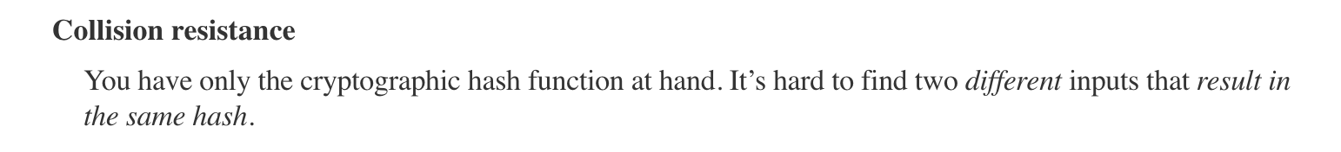
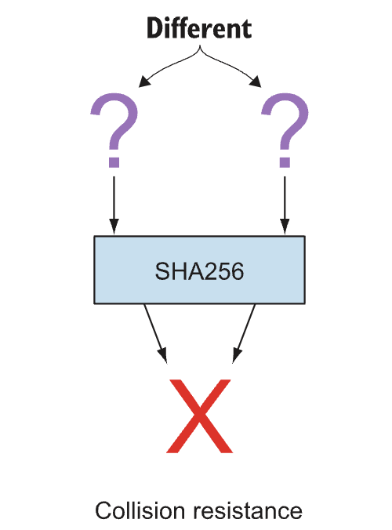

Slide 11
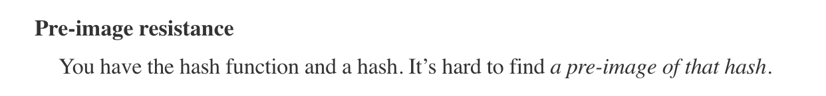
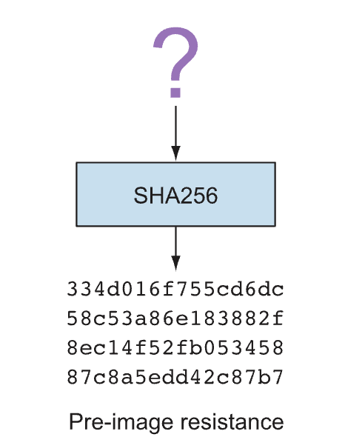

Slide 12
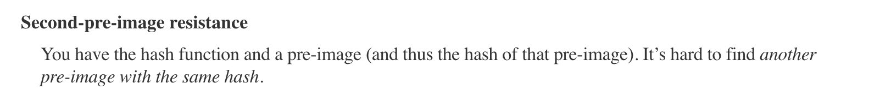
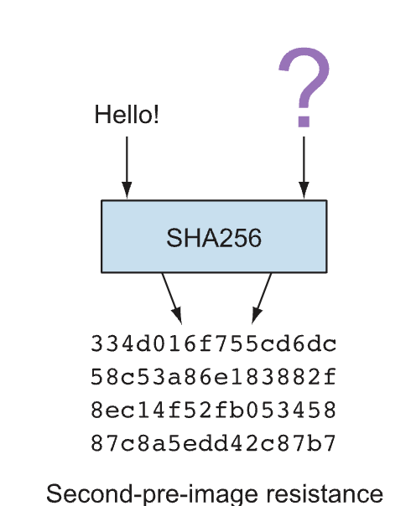

Slide 13
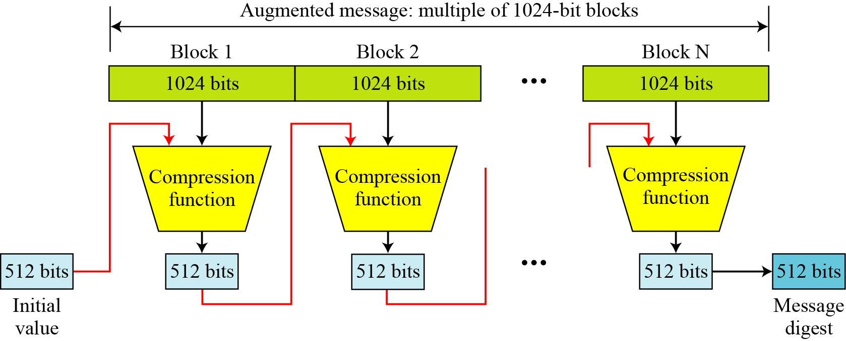
SHA-512 Overview
Notes:
Now examine the structure of SHA-512, noting that the other versions are quite similar.
SHA-512 follows the structure depicted in Stallings Figure 11.8. The processing consists of the following steps:
• Step 1: Append padding bits, consists of a single 1-bit followed by the necessary number of 0-bits, so that its length is congruent to 896 modulo 1024
• Step 2: Append length as an (big-endian) unsigned 128-bit integer
• Step 3: Initialize hash buffer to a set of 64-bit integer constants (see text)
• Step 4: Process the message in 1024-bit (128-word) blocks, which forms the heart of the algorithm. Each round takes as input the 512-bit buffer value H_{i}, and updates the contents of that buffer.
• Step 5: Output the final state value as the resulting hash
See text for more details.

Slide 14
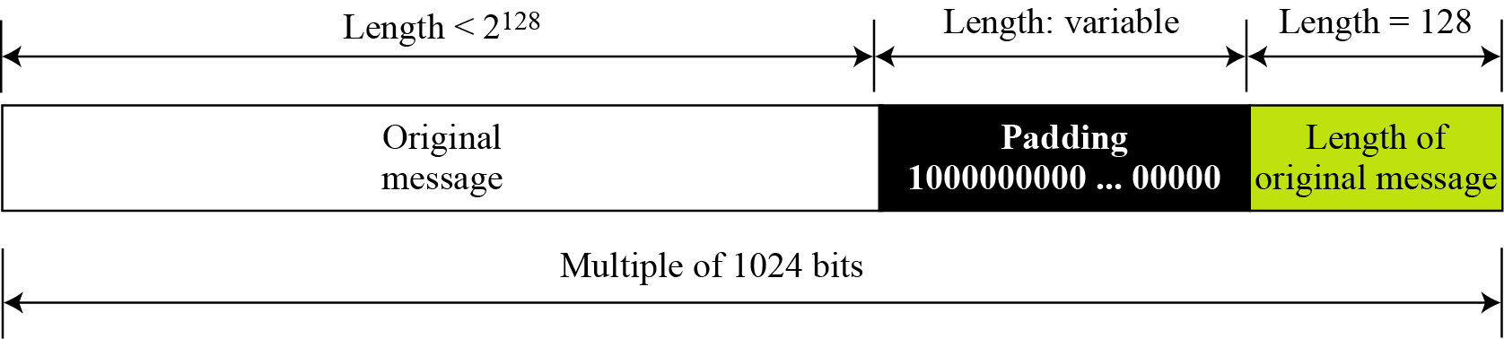
Padding and length field in SHA-512
What is the number of padding bits if the length of the original message is 2590 bits?
We can calculate the number of padding bits as follows:
The padding consists of one 1 followed by 353 0’s.

Slide 15
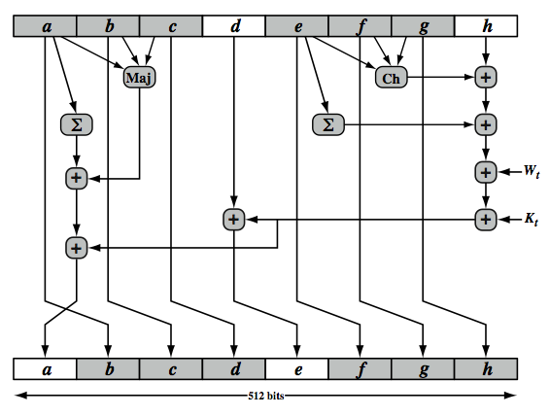
SHA-512 Round Function
Notes:
The structure of each of the 80 rounds is shown in Stallings Figure 11.10. Each 64-bit word is shuffled along one place, and in some cases manipulated using a series of simple logical functions (ANDs, NOTs, ORs, XORs, ROTates), in order to provide the avalanche & completeness properties of the hash function. The elements are:
Ch(e,f,g) = (e AND f) XOR (NOT e AND g)
Maj(a,b,c) = (a AND b) XOR (a AND c) XOR (b AND c)
∑(a) = ROTR(a,28) XOR ROTR(a,34) XOR ROTR(a,39)
∑(e) = ROTR(e,14) XOR ROTR(e,18) XOR ROTR(e,41)
+ = addition modulo 2^64
Kt = a 64-bit additive constant
Wt = a 64-bit word derived from the current 512-bit input block.
Six of the eight words of the output of the round function involve simply permutation (b, c, d, f, g, h) by means of rotation. This is indicated by shading in Figure 11.10. Only two of the output words (a, e) are generated by substitution. Word e is a function of input variables d, e, f, g, h, as well as the round word W t and the constant Kt. Word a is a function of all of the input variables, as well as the round word W t and the constant Kt.

Slide 16
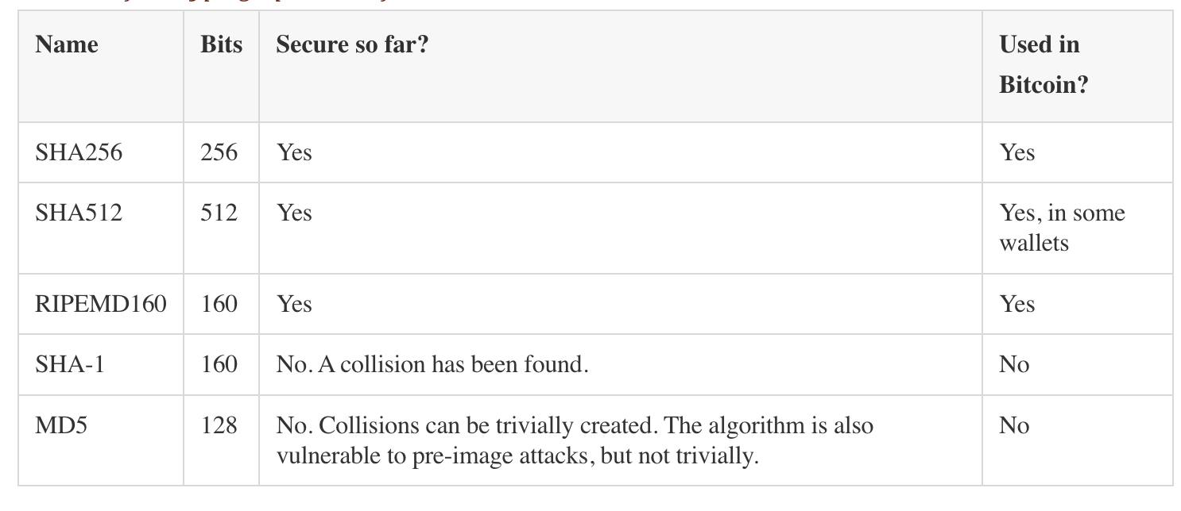
Some well-known hash functions

Slide 17
Patterns of Hashing Data
Independent hashing
Repeated hashing
Combined hashing
Sequential hashing
Hierarchical hashing
Courtesy: Blockchain Basics: A Non-Technical Introduction in 25 Steps by Daniel Drescher

Slide 18
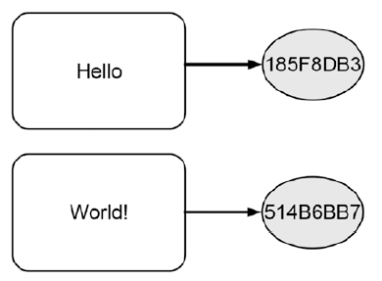
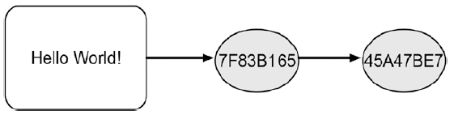
Types of Hashing
Independent hashing
Repeated hashing

Slide 19
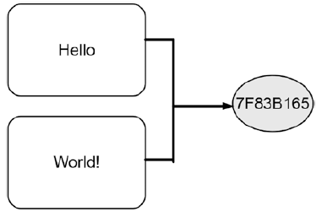
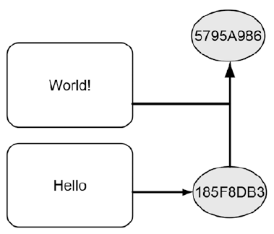
Types of Hashing
Combined hashing
Sequential hashing

Slide 20
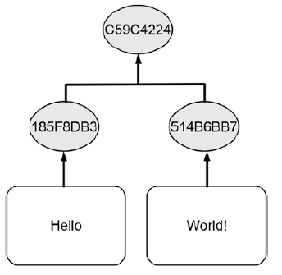
Types of Hashing
Hierarchical hashing

Slide 21
Hash Pointer
A Cryptographic Hash Pointer (Often called Hash Reference) is a pointer to a location where
Some information is stored
Hash of the information is stored
With the hash pointer, we can
Retrieve the information
Check that the information has not been modified (by computing the message digest and then matching the digest with the stored hash value)

Slide 22
Hash Pointer
H(DATA)
DATA
Hash Pointer

Slide 23
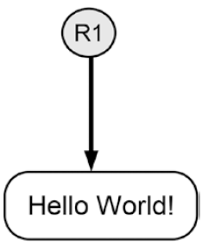

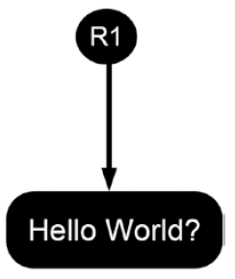
Tamper Detection using Hash Pointer

Slide 24
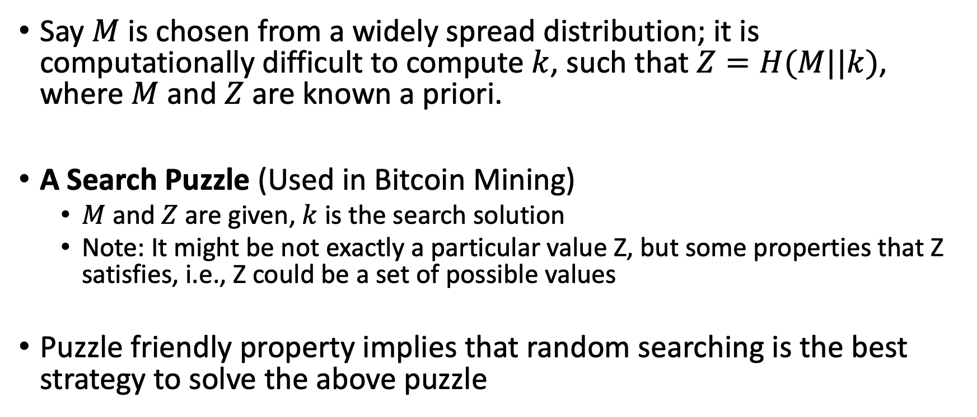
Puzzle Friendly
Say $M$ is chosen from a widely spread distribution; it is computationally difficult to compute $k$, such that $Z=H(M||k)$, where $M$ and $Z$ are known a priori.
A Search Puzzle (Used in Bitcoin Mining)
$M$ and $Z$ are given, $k$ is the search solution
Note: It might be not exactly a particular value Z, but some properties that Z satisfies, i.e., Z could be a set of possible values
Puzzle friendly property implies that random searching is the best strategy to solve the above puzzle

Slide 25
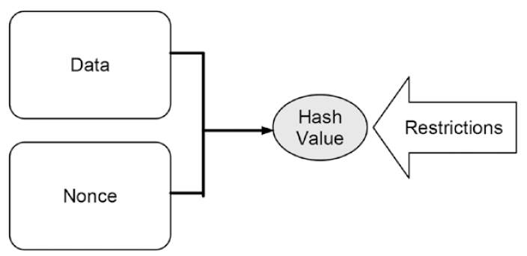
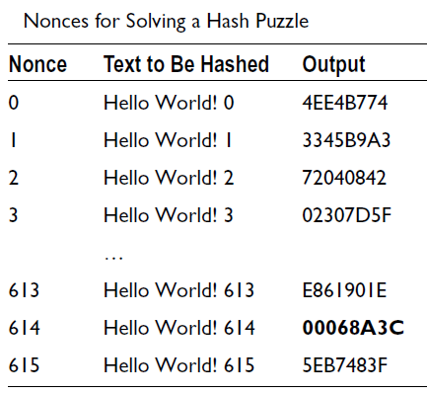
Making Tampering a Hash Chain Computationally Challenging
http://www.blockchain-basics.com/HashFunctions.html
Courtesy: Blockchain Basics: A Non-Technical Introduction in 25 Steps by Daniel Drescher

Slide 26
Detect Tampering from Hash Pointers - Hashchain
H(D^{(i-1)})
H(D^{(i)})
H(D^{(i+1)})
D^{(i)}
D^{(i+1)}
D^{(i+2)}

Slide 27
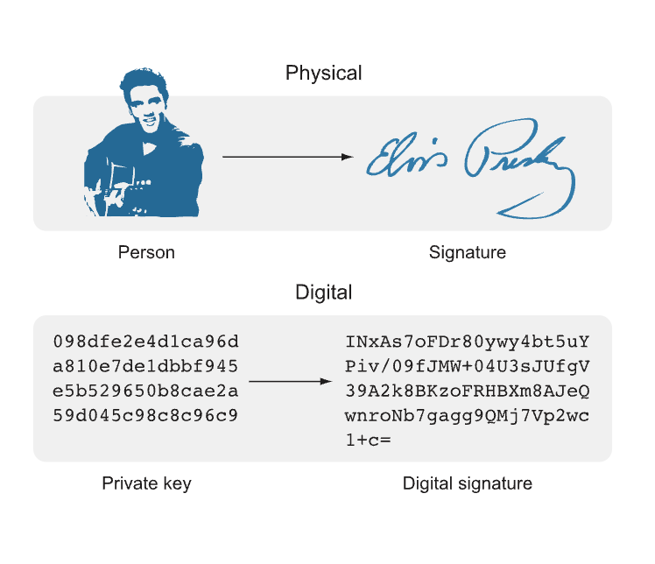
Digital Signatures

Slide 28
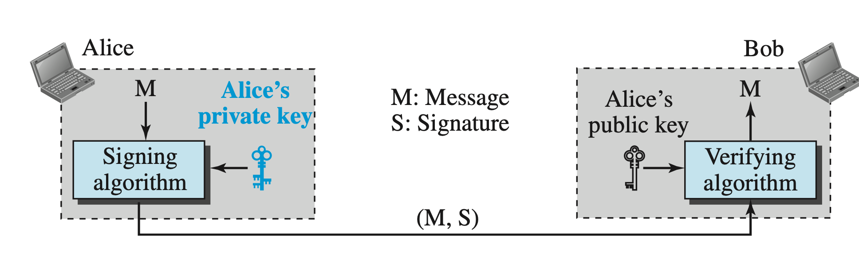
Digital Signature

Slide 29
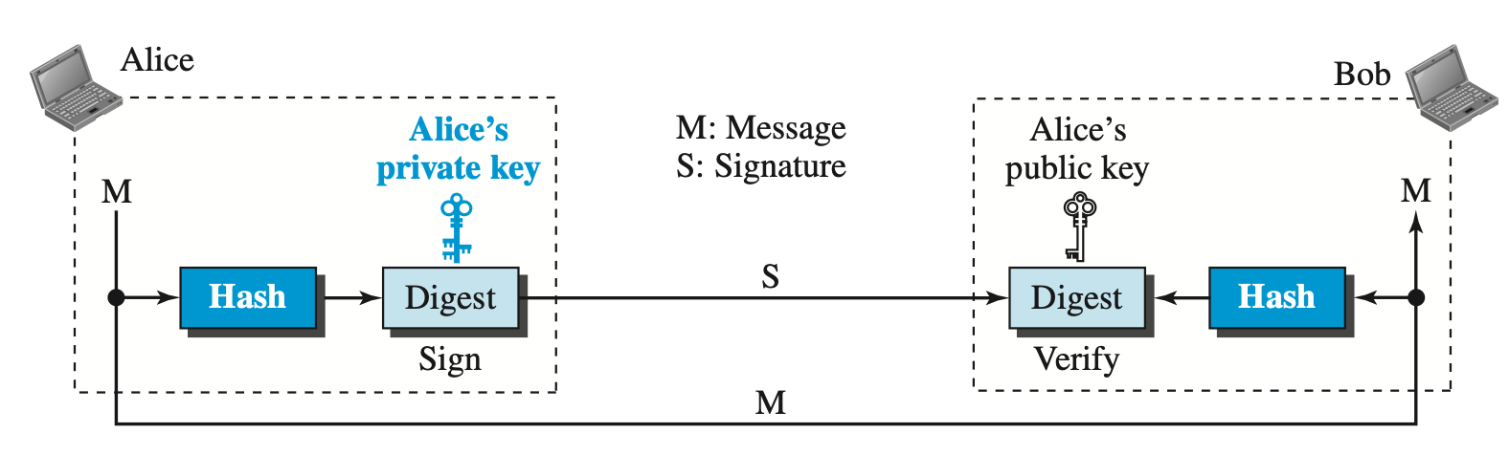
Digital Signature
A digital signature needs a public-key system. The signer signs with her private key; the verifier verifies with the signer’s public key.
A cryptosystem uses the public and private keys of the receiver; a digital signature uses the private and public keys of the sender.

Slide 30

Digital Signatures

Slide 31
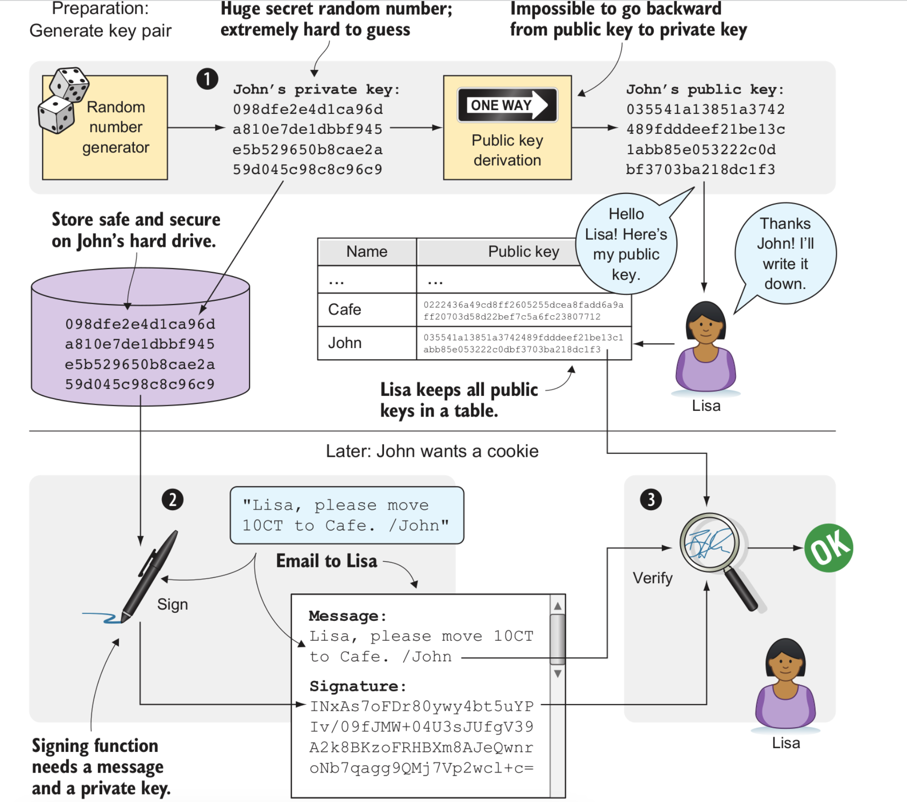
Digital Signatures

Slide 32
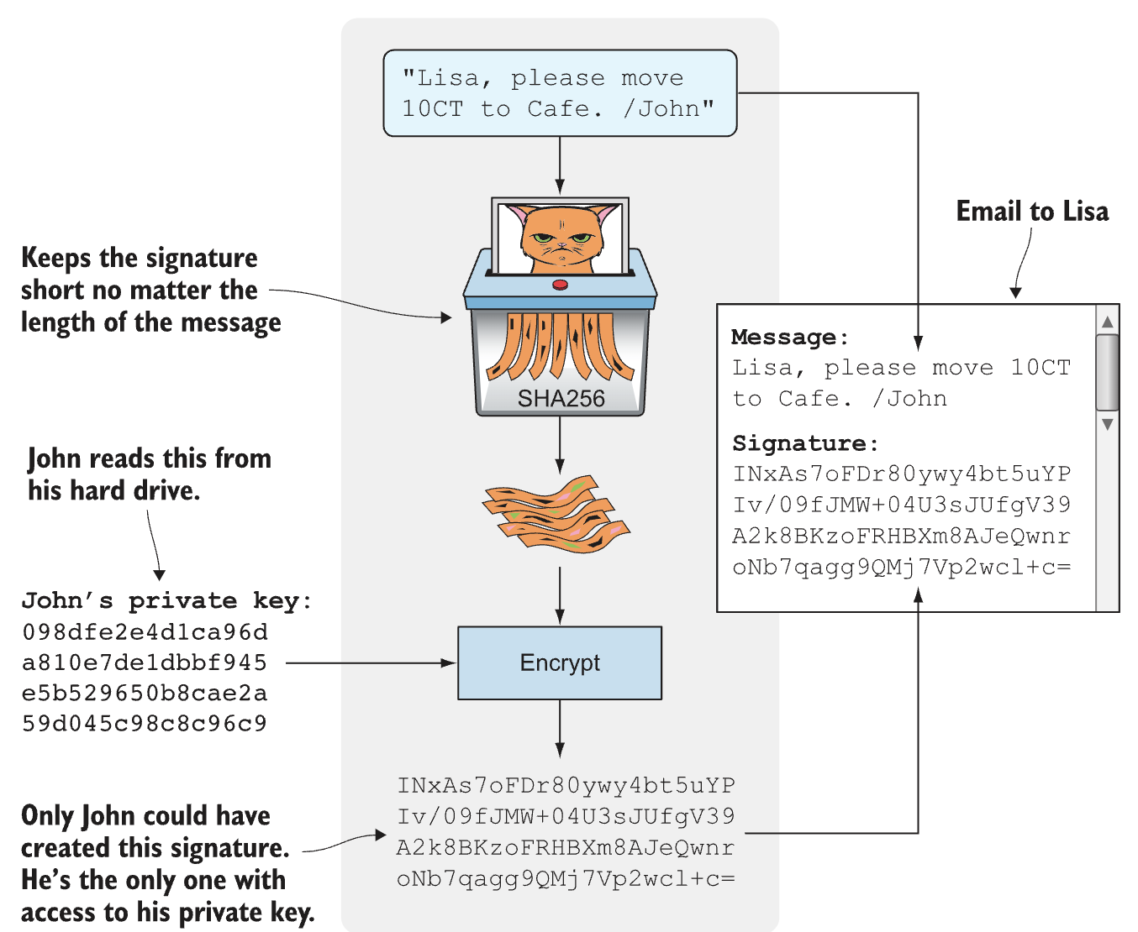
Digital Signatures

Slide 33
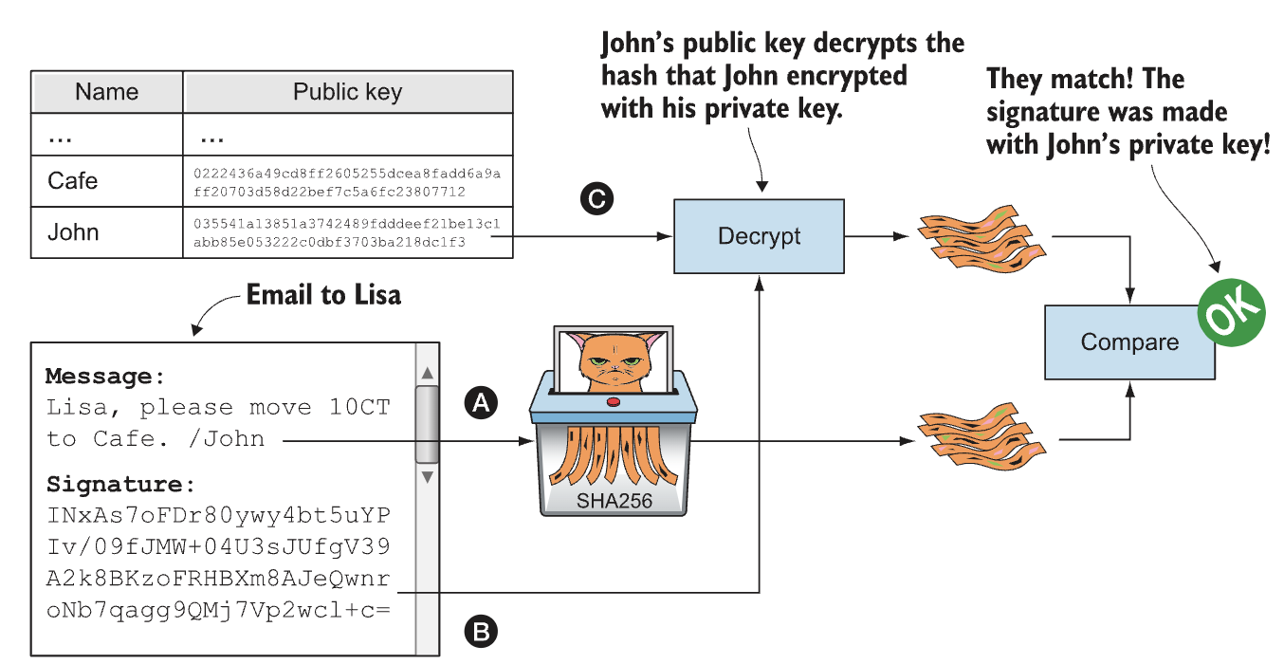
Digital Signatures

Slide 34
Demo
https://learn.pkiindia.in/index.html

Slide 35
Merkle Tree – Organization of Hash Pointers in a Tree
Root Hash
H_{root}=Hash(H₀+H₁)
Merkle Root
L₁ Hash
H₀= Hash(H₀₀+H₀₁)
L₁ Hash
H₁=Hash(H₁₀+H₁₁)
L₂ Hash
H₀₀=Hash(T₁)
L₂ Hash
H₀₁=Hash(T₂)
L₂ Hash
H₁₀=Hash(T₃)
L₂ Hash
H₁₁=Hash(T₄)
T₁
T₂
T₃
T₄

Slide 36
Blockchain as a Hashchain
Block Header
Block Header
Block Header
Previous Hash
Nonce
Previous Hash
Nonce
Previous Hash
Nonce
Merkle Root
Block Hash
Merkle Root
Block Hash
Merkle Root
Block Hash

Slide 37
Demo
http://www.blockchain-basics.com/HashFunctions.html
https://andersbrownworth.com/blockchain/blockchain
https://andersbrownworth.com/blockchain/public-private-keys/keys

